Slide 1
The state of Microsoft Search as of Q4 2023
Kasper Larsen, senior solution architect

Slide 2






Kasper Larsen (He/Him)
Contact Info
@kasperbolarsen
kasperbolarsen
PnP Modern Search & PnP Script Samples
Odense, Denmark
Senior Solution Architect at Fellowmind Denmark
3 October 2023

Slide 3

History – the World as we knew it
SharePoint Search vs Microsoft Search
Search & Intelligence Admin Center
Data sources
Customizations
Scenarios for MS Graph Connectors
Graph connector costs
Alternatives

Slide 4
History – the World as we know it
01

Slide 5
SharePoint Search (SP2013->) SharePoint Modern – Only OOTB (PnP Modern search as alternative) Microsoft Search (2021-> )

Slide 6
SharePoint Search vs Microsoft Search

Slide 7
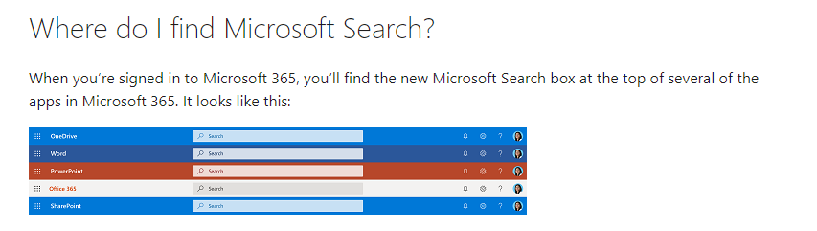

Slide 8
Insights
Search & Intelligence Admin Center

Slide 9
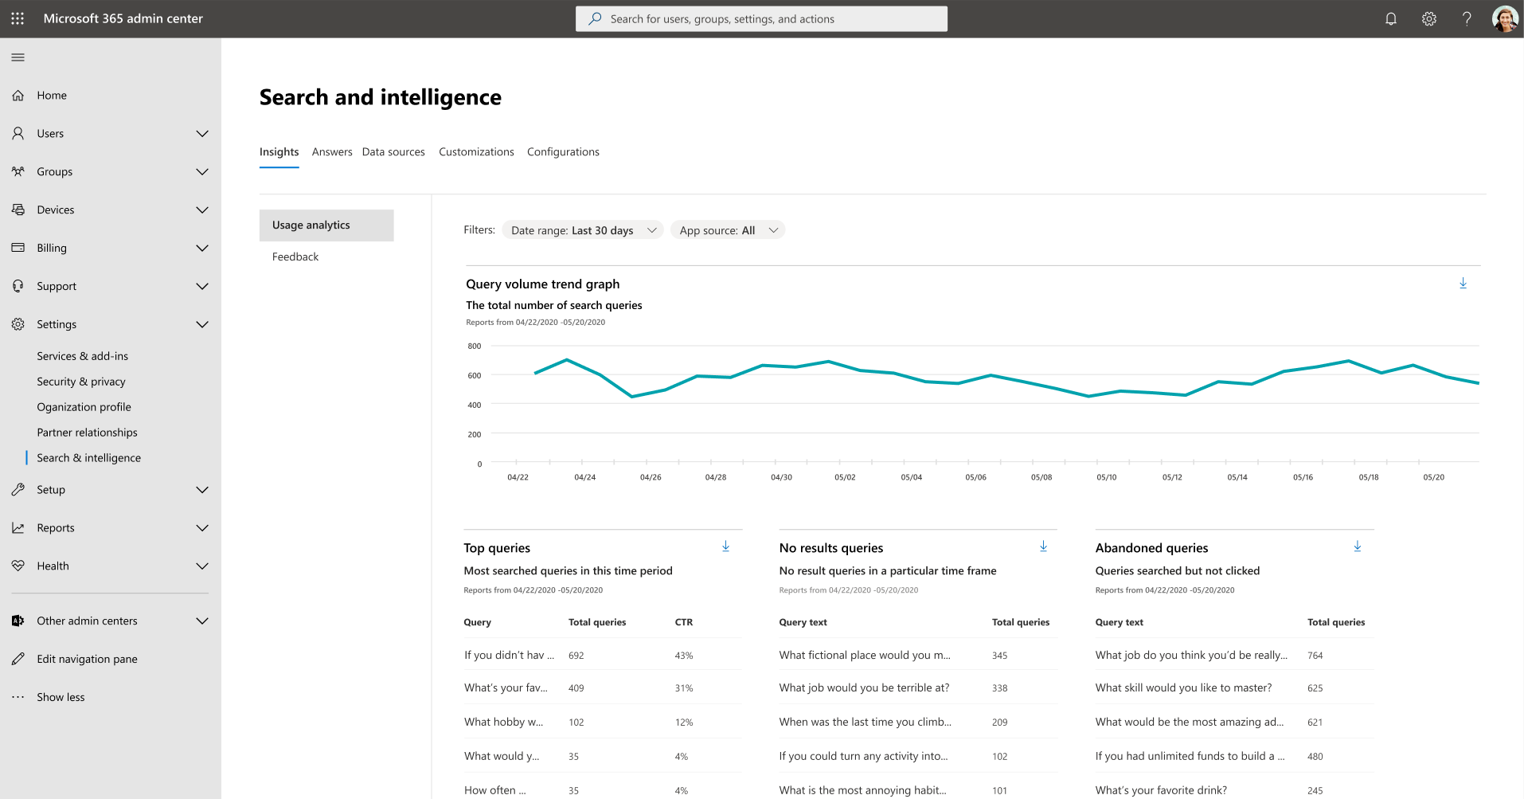

Slide 10
Data sources
Search & Intelligence Admin Center

Slide 11
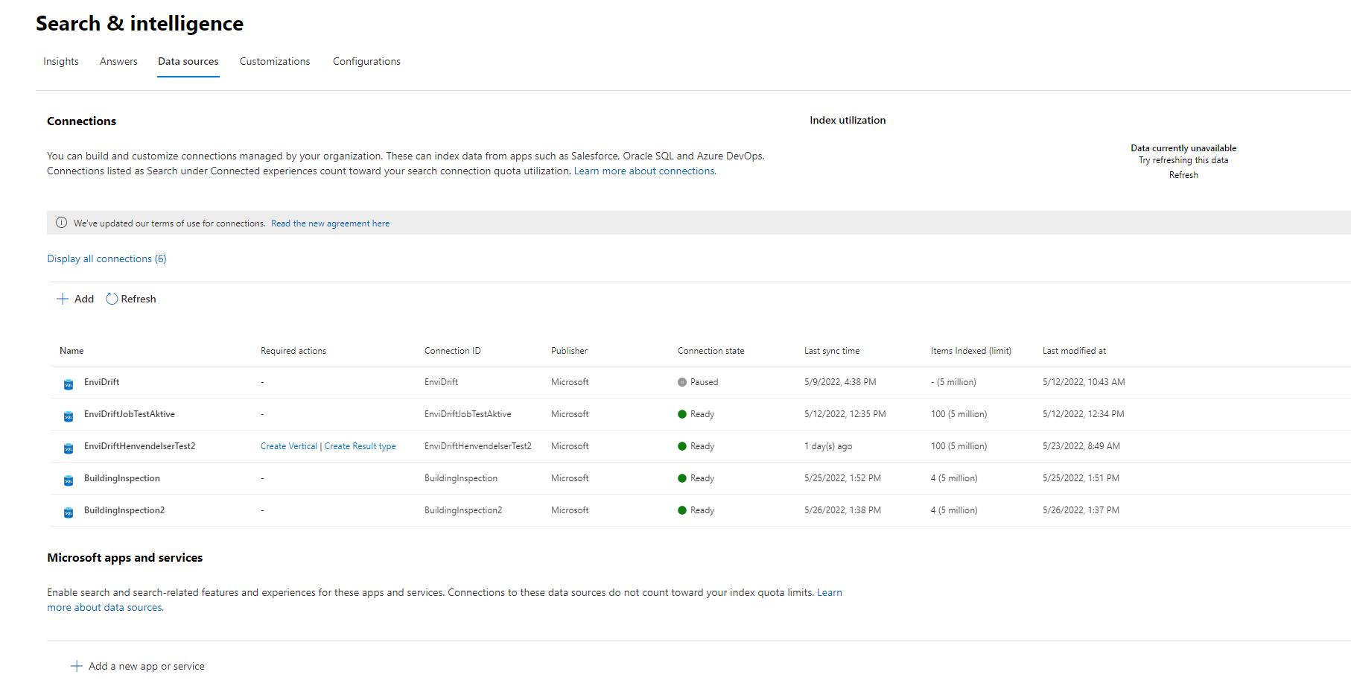

Slide 12
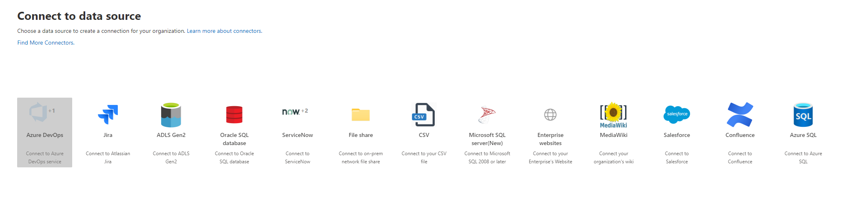

Slide 13
Customizations
Search & Intelligence Admin Center

Slide 14
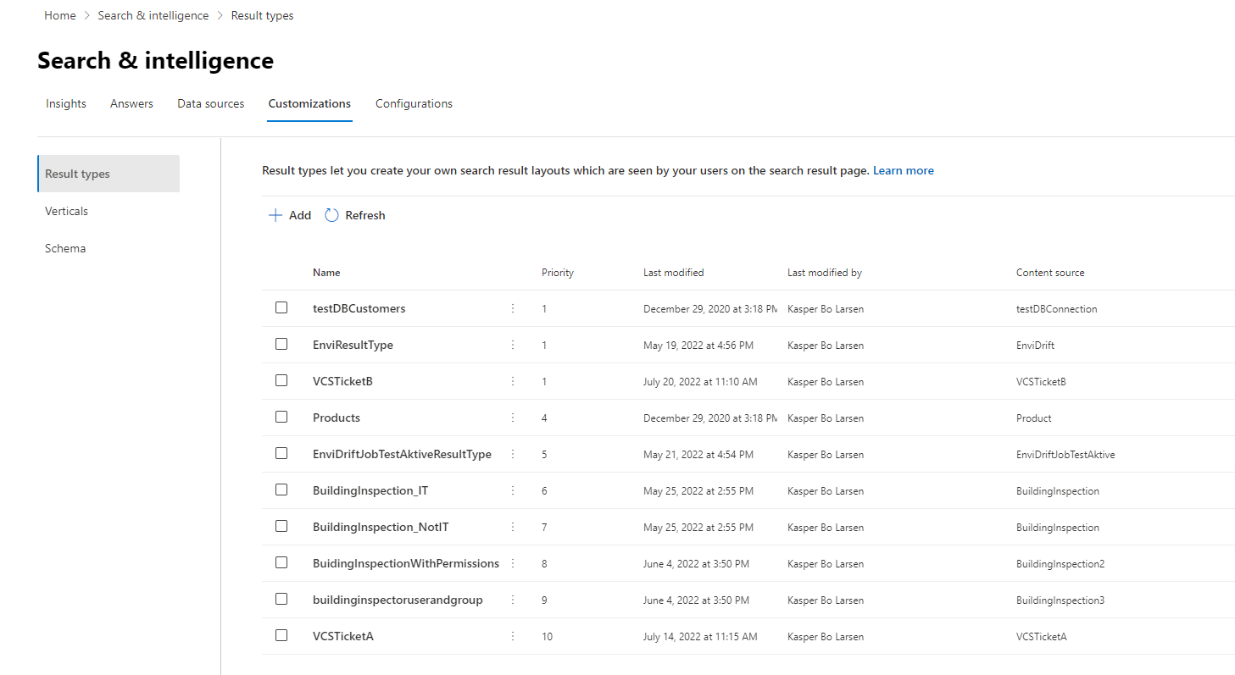

Slide 15
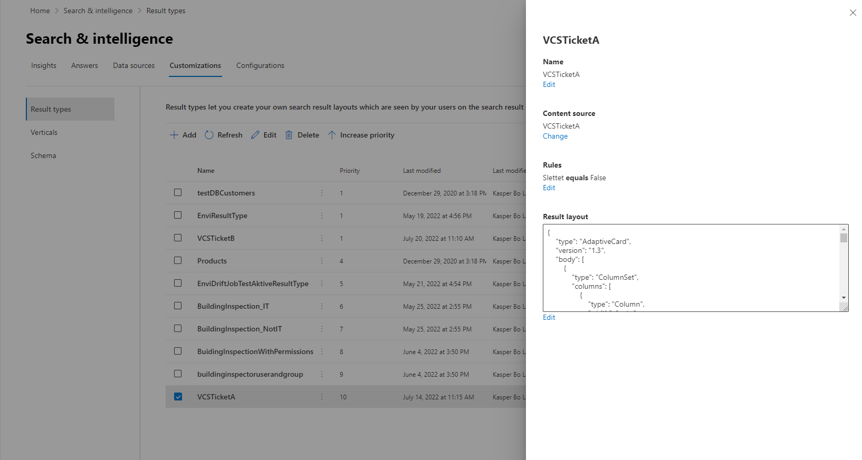

Slide 16
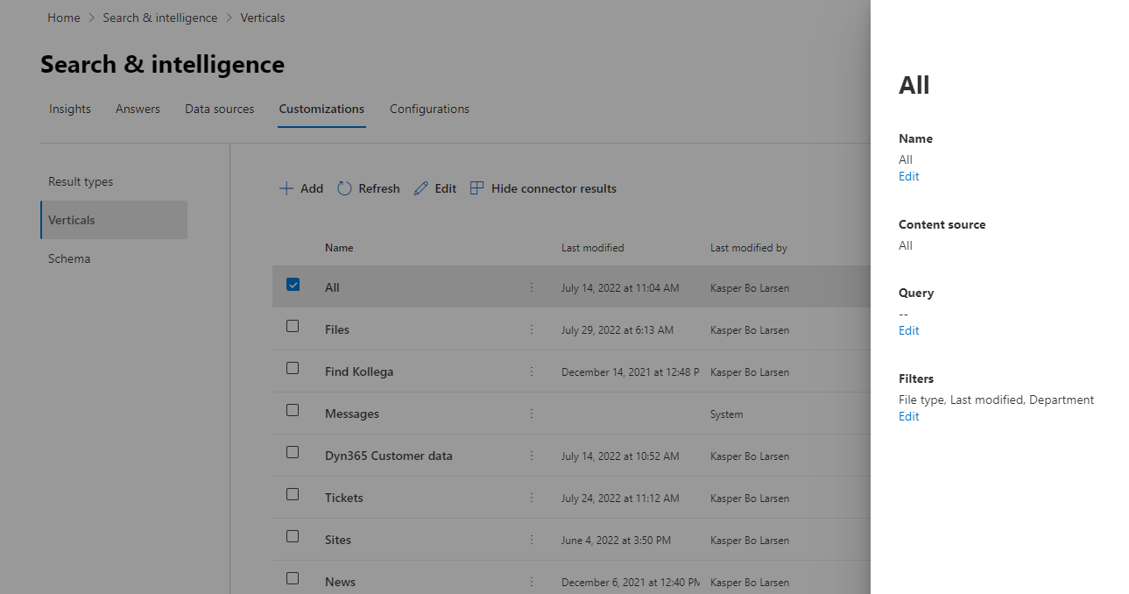

Slide 17
Scenarios for MS Graph Connectors

Slide 18
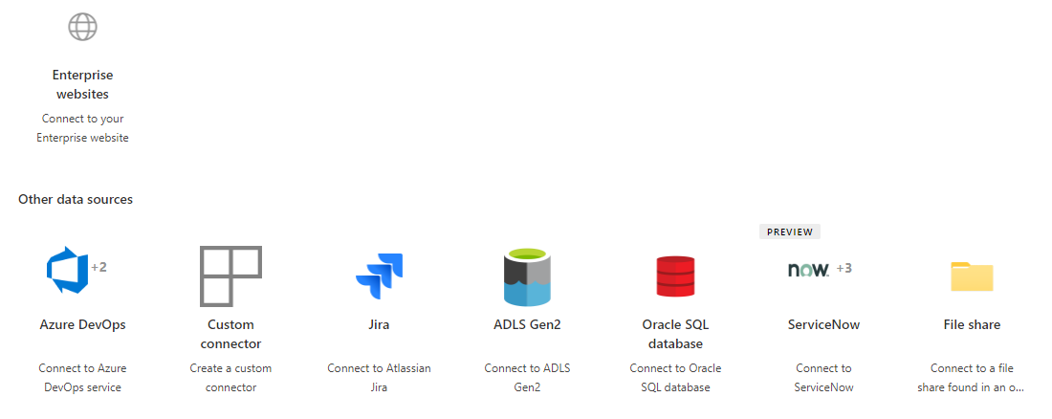
Bringing 3rd party data into M365, connector by MS

Slide 19
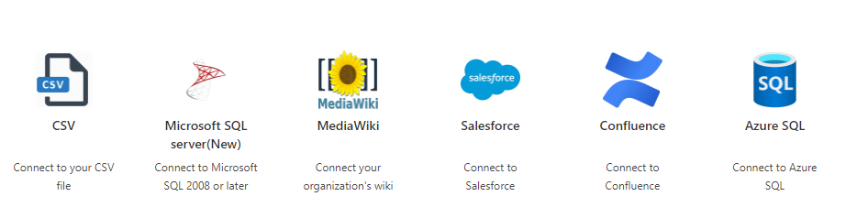
Bringing 3rd party data into M365, connector by MS

Slide 20
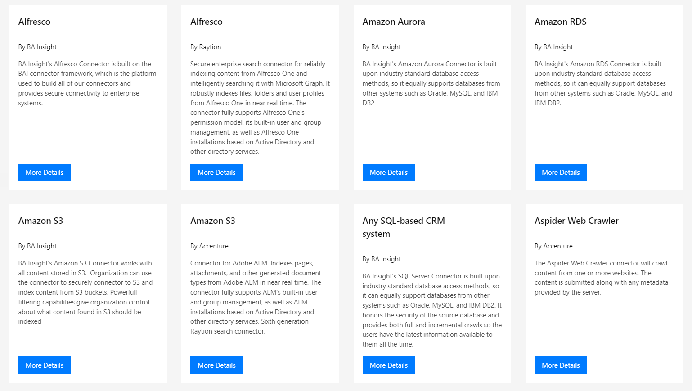
Bringing 3rd party data into M365, Connectors by ISVs

Slide 21
Bringing 3rd party data into M365, DIY Connectors
Build your first custom Microsoft Graph connector | Microsoft Learn

Slide 22
Microsoft Graph Connector limits

Slide 23
Microsoft Graph connectors
Max 30 connectors per tenant

Slide 24
Microsoft Graph connectors support up to 50 million items of total index quota
The per connection item limit is 5 million items by default*.

Slide 25
Microsoft Graph Connector cost

Slide 26
Entitlement: 500 items for each Microsoft 365 E5 or Office 365 E5 license
Cost of indexing connector content is $1000/month for each million items

Slide 27
Alternatives

Slide 28
Migrate content into SharePoint Pro: simple and well known Cons: SP Storage cost + sync job

Slide 29
Keep the data in the source system and develop a custom web part

Slide 30
Syntex Repository Services ?

Slide 31


Slide 32
Links Microsoft Search - Intelligent search for the modern workplace (Graph Connectors) (59) How Microsoft 365 Copilot can work with your external data - YouTube Introducing Syntex repository services: Microsoft 365 superpowers for your app

